Slide 1
Invitation to the K-GMT
Myung Gyoon LEE
(K-GMT SWIG/Seoul National University)
GMT2010: Opening New Frontiers with the GMT
2010.10.4-6, Seoul National University, Seoul, Korea

Slide 2
Welcome to GMT2010!
환영합니다!
(Hwan-yeong-ham-ni-da!)

Slide 3
A Brief History of Korean Astronomy
Past
  Rich in astronomical observations
Present
  Working hard!
Future
  A giant leap with the GMT

Slide 4
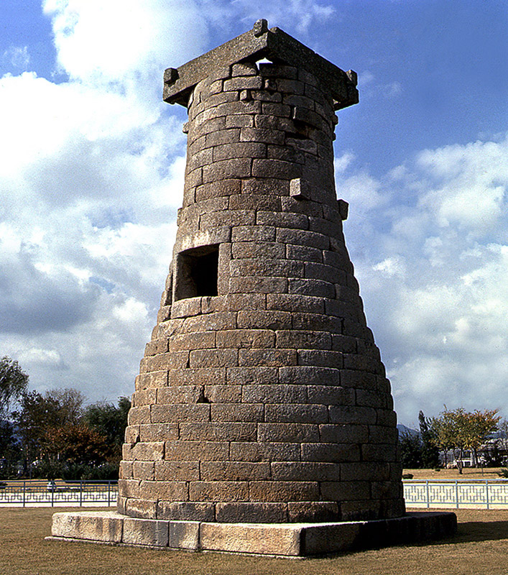
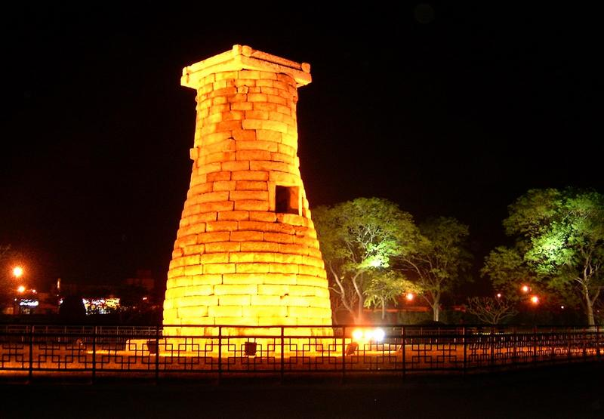
The Oldest Observatory in Asia
Cheom-seong-dae (Built on AD 633)
  (meaning ‘a place for observing stars’)
  Located in the old capital of shilla dynasty (BC1C – 10C)
  N(brick)=362 in 27 steps
  Operated by royal astronomers

Slide 5
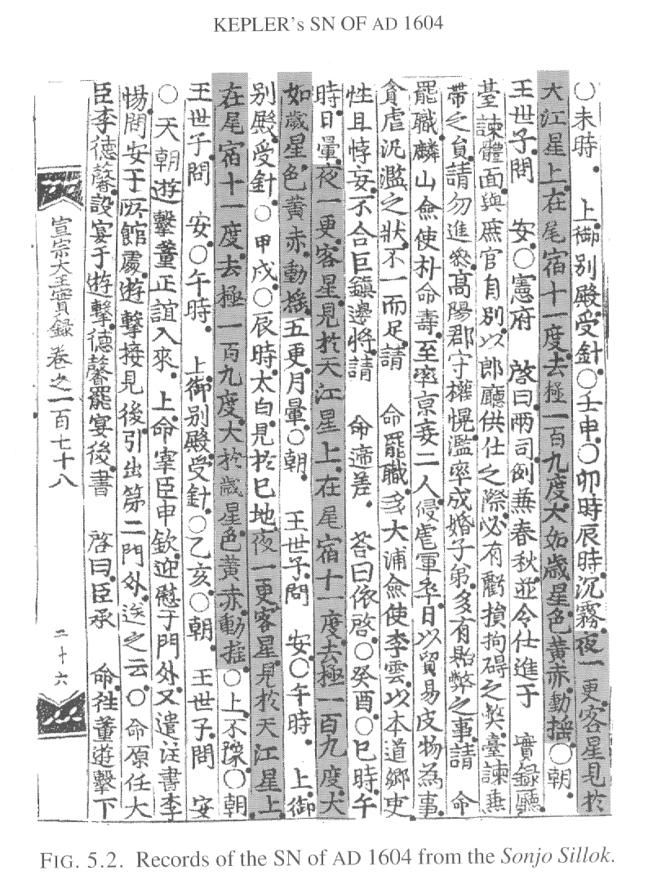
Very Early Photometry of Stars
SN 1604 (Kepler’s SN)
  Discovered in Europe and China
  Monitoring for ~6 months after 3 days of discovery by court astronomers of Chosun dynasty (14C-19C)
  Recorded in the Royal Record
    (“In 1604 Oct ??, a guest star appeared …. it was scintillating with yellow to red color like Jupiter…).

Slide 6
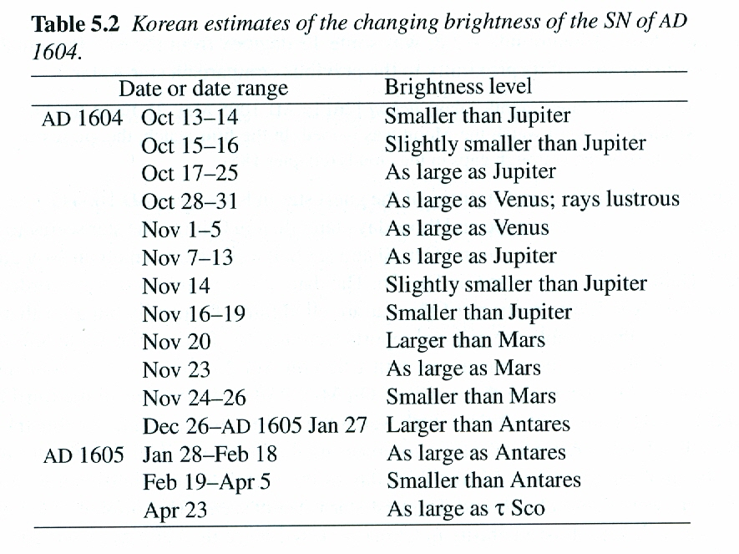
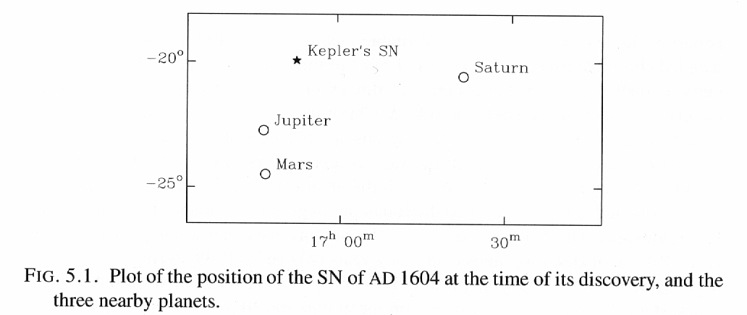
Photometry of SN1604
Visual relative photometry of SN 1604
Comparison objects: planets and bright stars
    (Clark & Stephenson 1977, Stephenson & Green 2002)

Slide 7
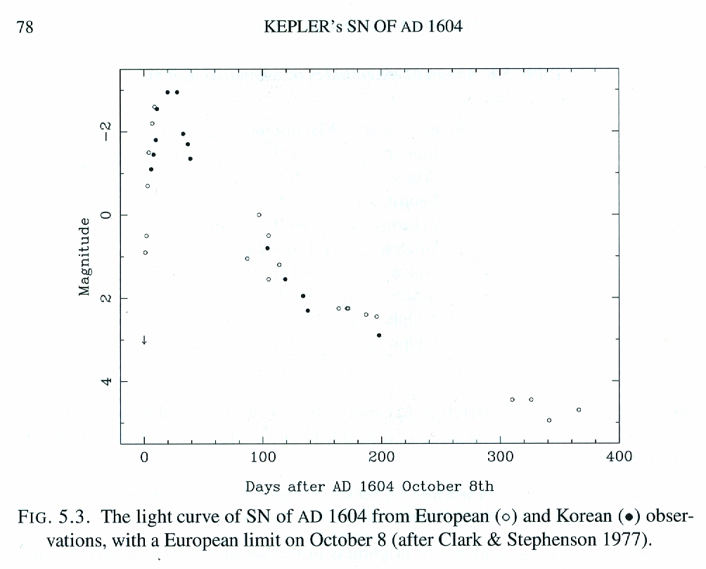
Photometry of Kepler SN1604
Light curve of SN 1604
  European photometry (Baade 1943)
  Korean photometry (Clark & Stephenson 1977)-covering the maximum!
Type of SN 1604: I?

Slide 8
Current Astronomy in Korea
People
  N(institutions): KASI+several universities
  N(astronomers)~ 150-200 (including 109 IAU members)
  N(graduate students) ~100
Telescopes
  1975-: 60cm at SOAO
  1996-: 1.8m (Leap telescope) at BOAO
Research (observational astronomy)
  mostly using foreign facilities and archive as well as domestic ones

Slide 9
Future
Korea has been slow in getting telescopes.
The GMT will be a Giant Leap for Korea.
  From 1.8m (‘leap telescope’) to 25m
  (this ratio is the world record?)
A golden era astronomy is coming to Korea.

Slide 10
K-GMT Activity 1
2009
  1) Feb: Korea (KASI) joined the GMT with the government fund
  2) K-GMT Science & Instrumentation Working Group
  (Chair: M.G. Lee)
  3) Aug: Korean Academy of Science & Technology Symposium:
  “Giant Telescopes & Korean Astronomy”
(including David Lambert & Pat McCarthy)
2010
  1) Aug: K-GMT Summer School (8.19-20, ~90 attendants)

Slide 11
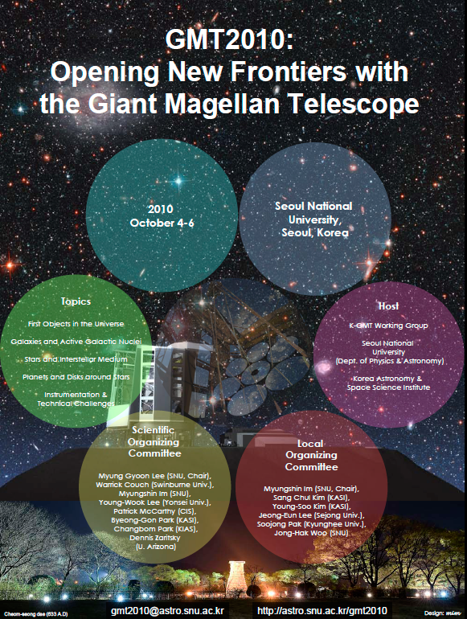
Activity 2
2010.10: GMT2010 international workshop (Oct 4-6)

Slide 12
GMT2010 will be a stepping stone for the success of GMT and a quantum jump of
Korean astronomy!
Enjoy GMT2010!

